Slide 1
第五次习题课
曹子尧
2025.05.09

Slide 2
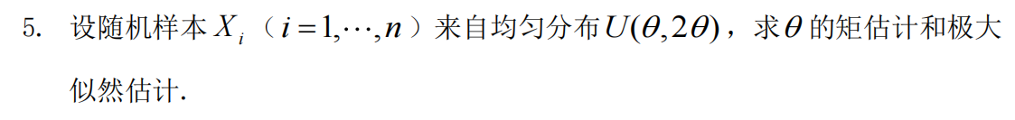
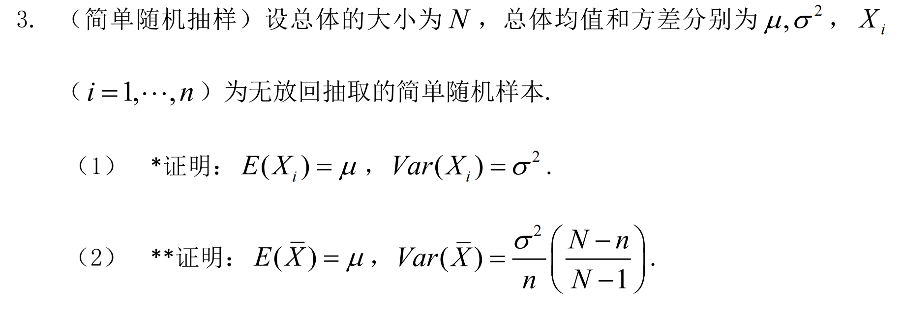
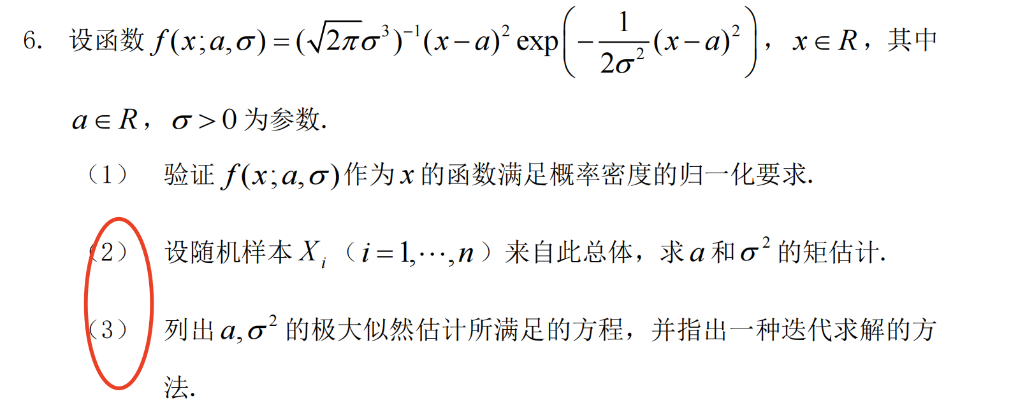
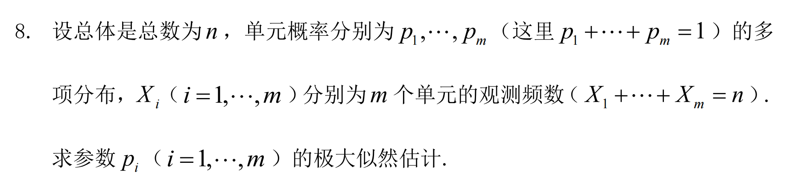
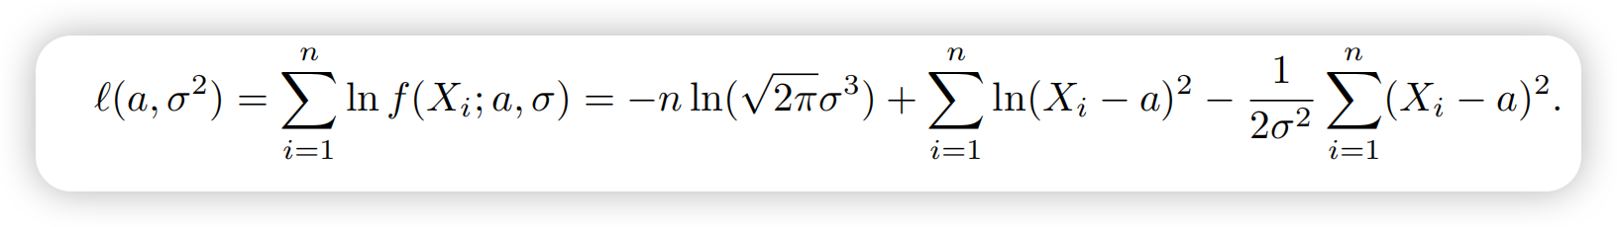
作业题

Slide 3
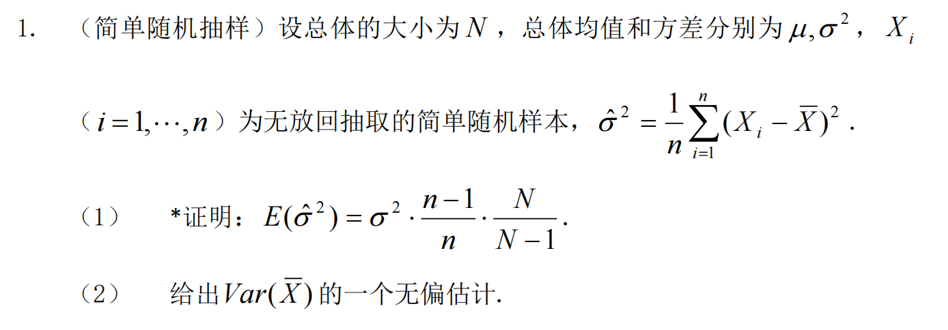
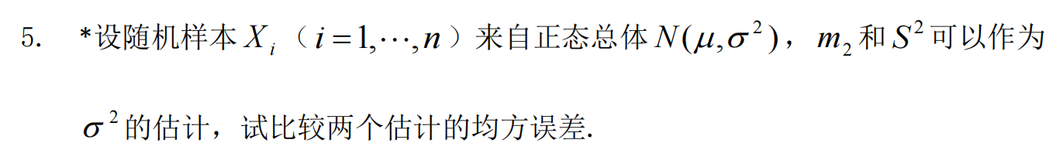
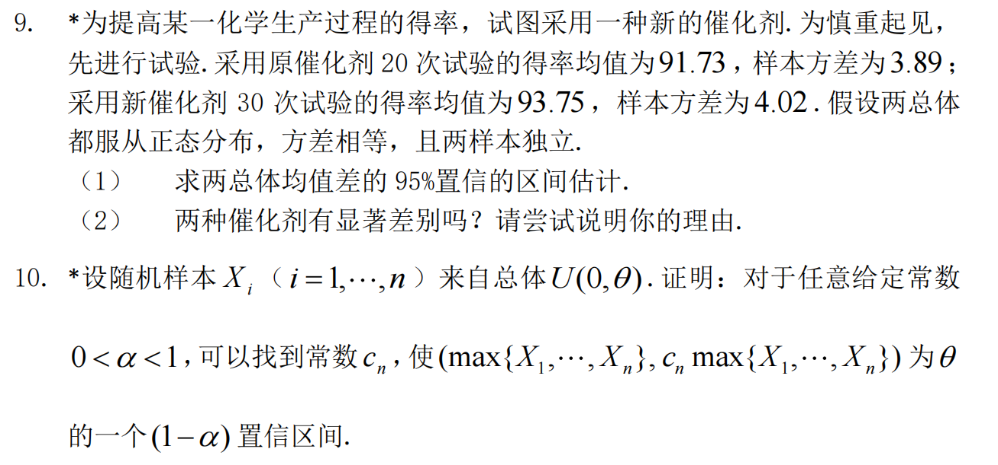
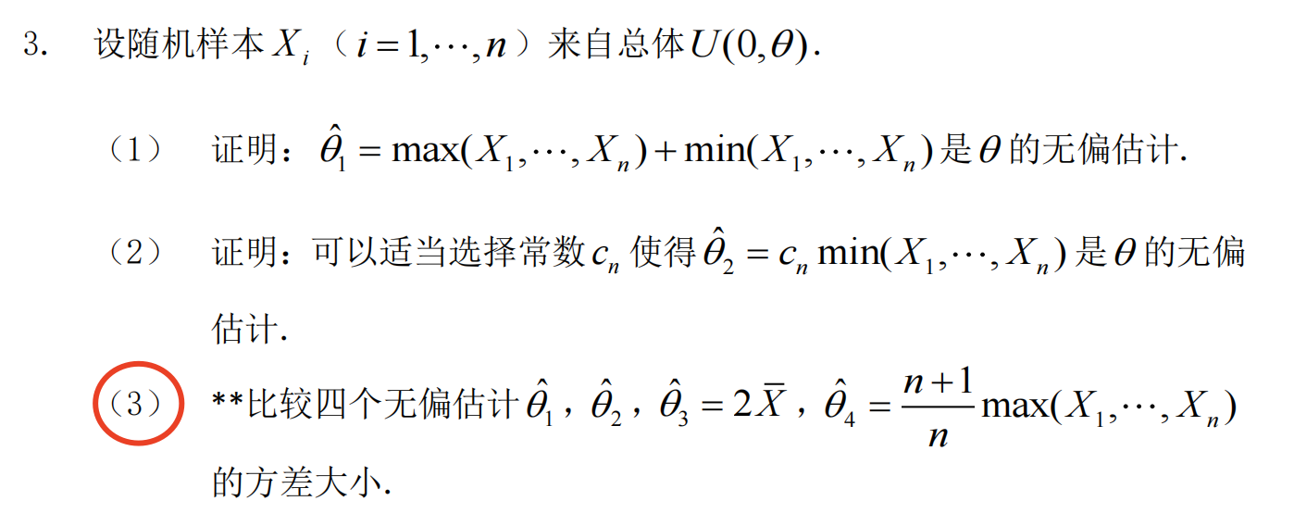
作业题

Slide 4
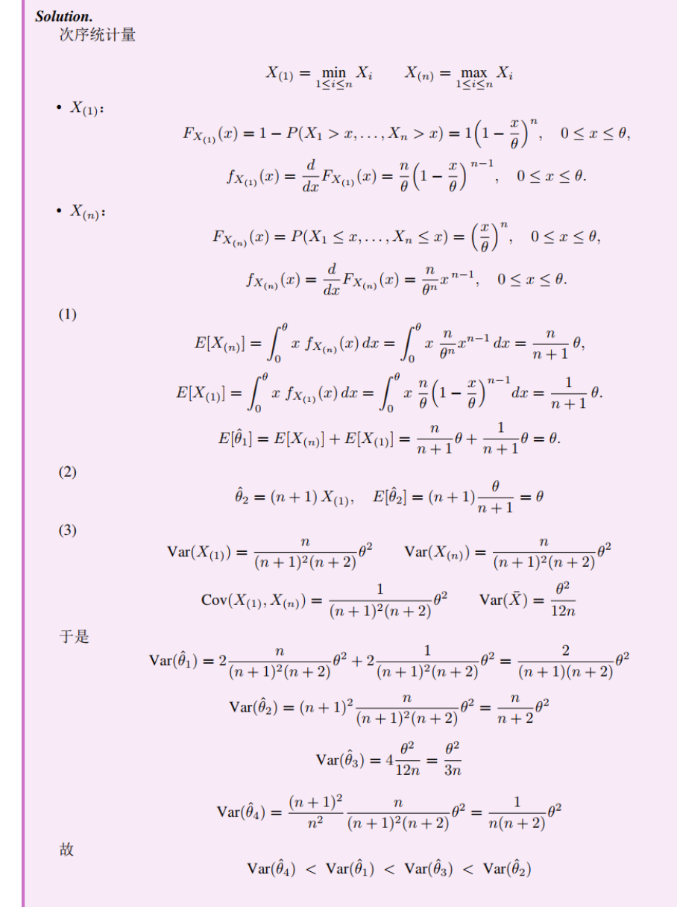
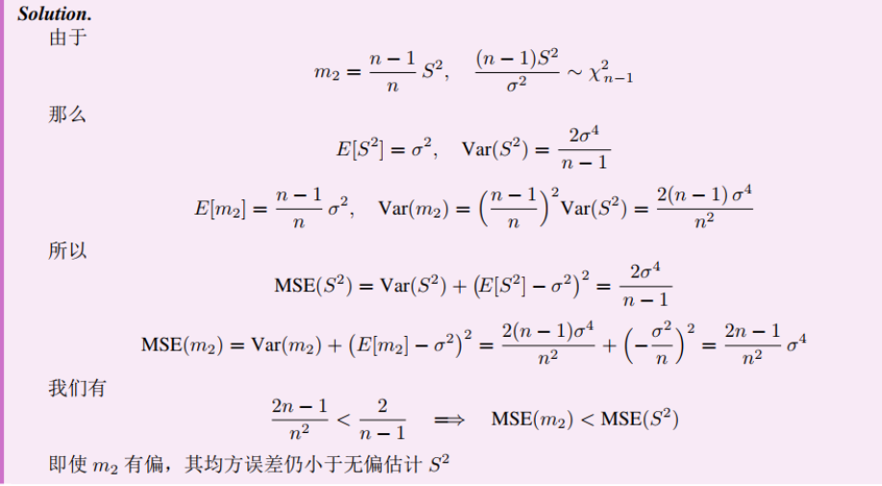
3 题、5题的详细过程
来自杜铭泽同学的优秀作业

Slide 5
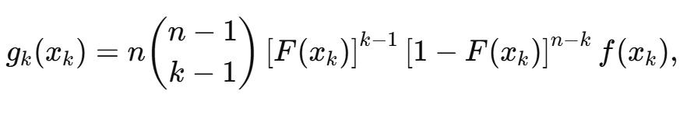
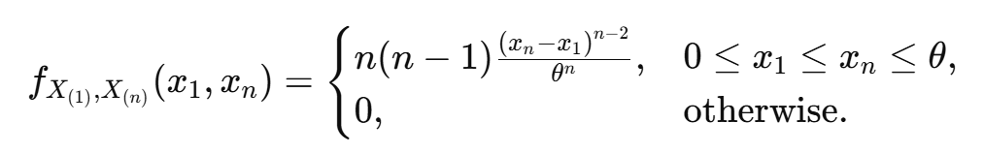
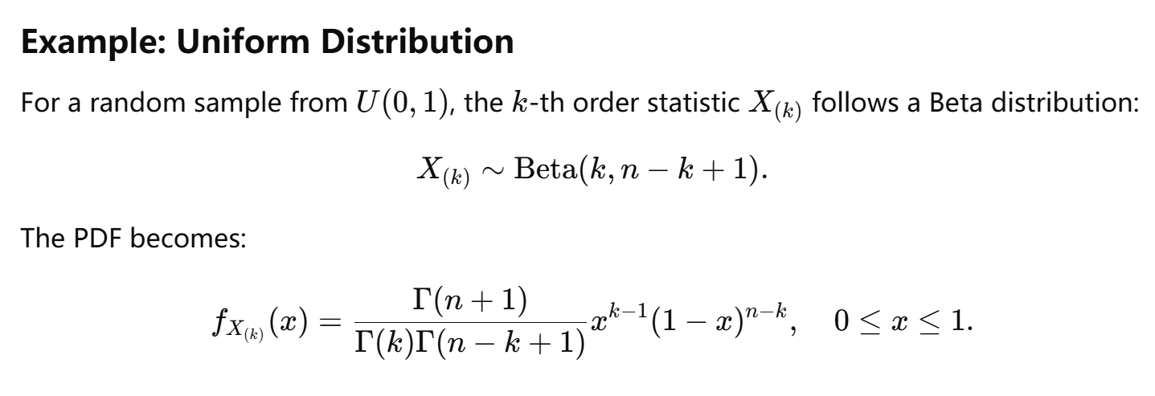
次序统计量
U（0,θ）

Slide 6
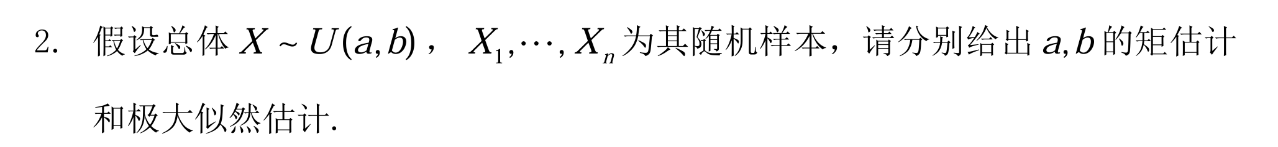
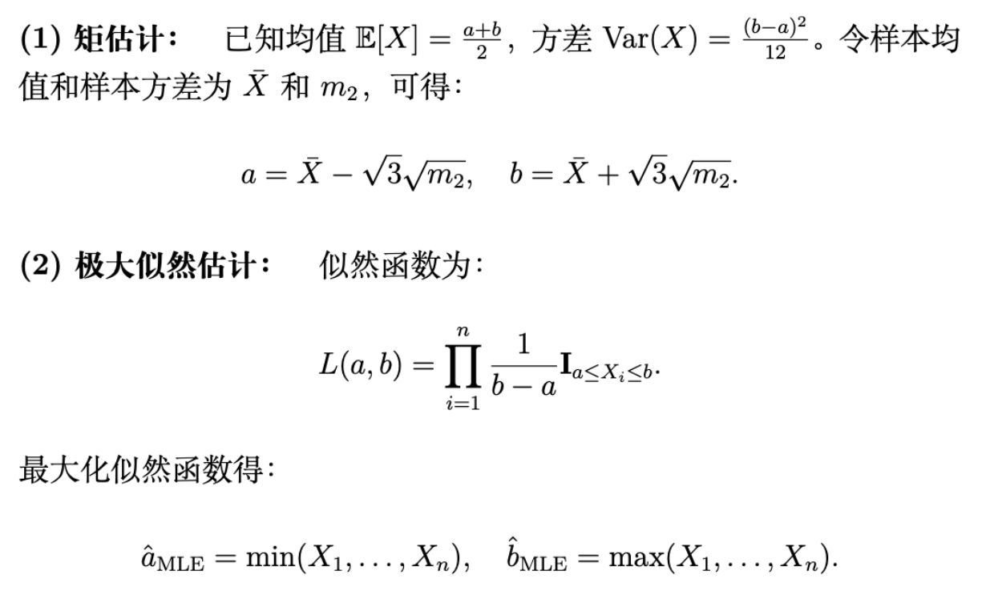

Slide 7
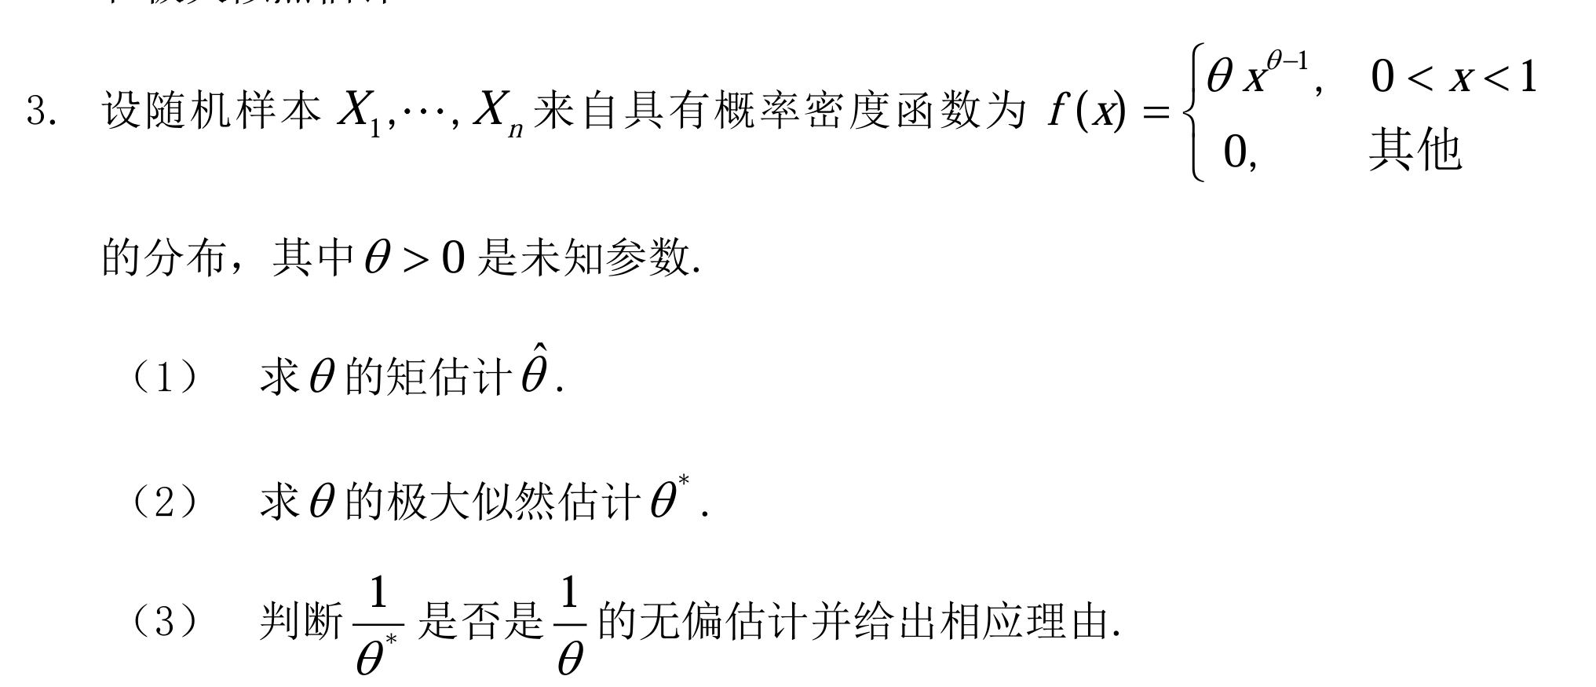
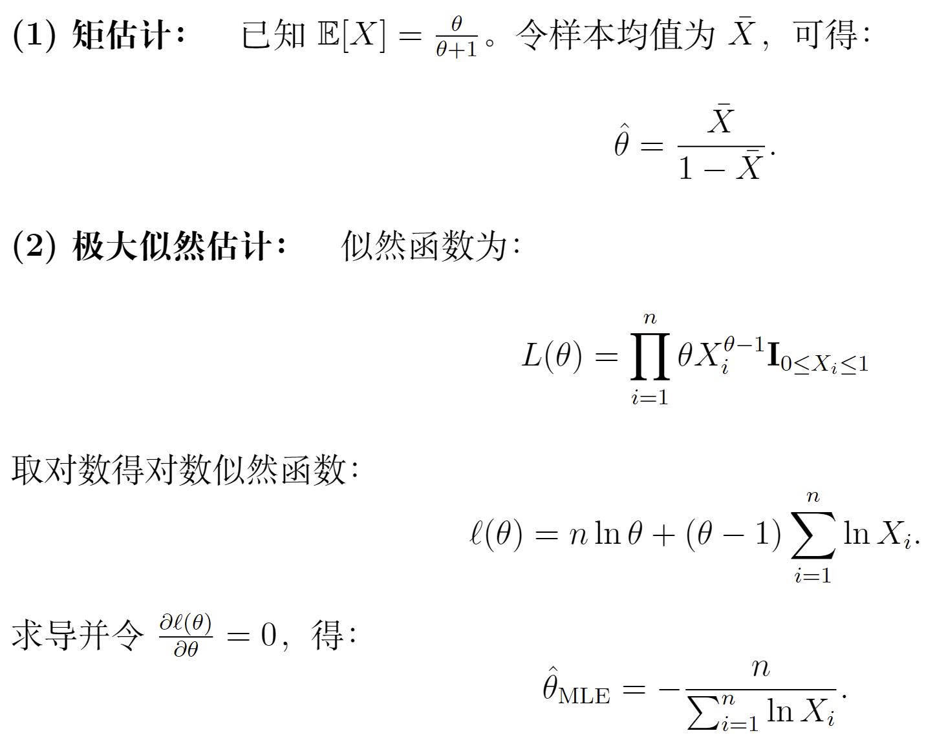
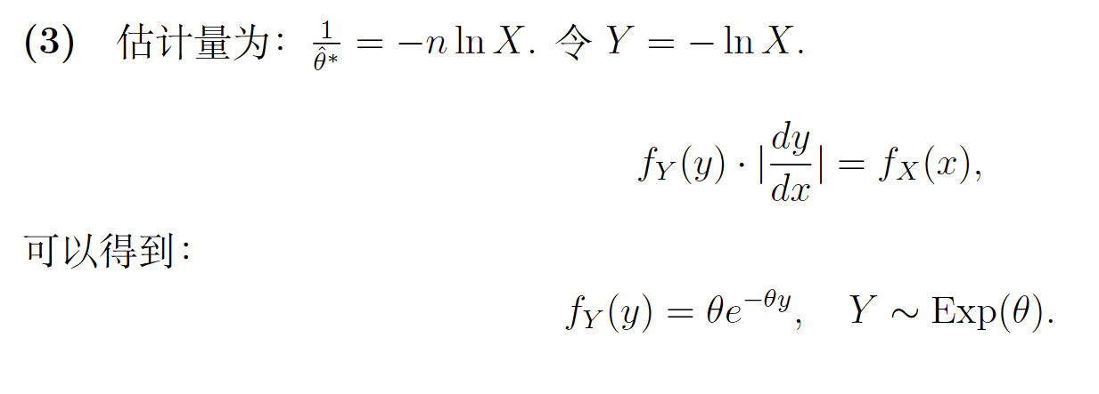
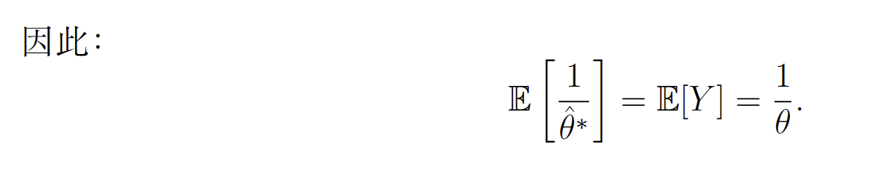
-lnX

Slide 8
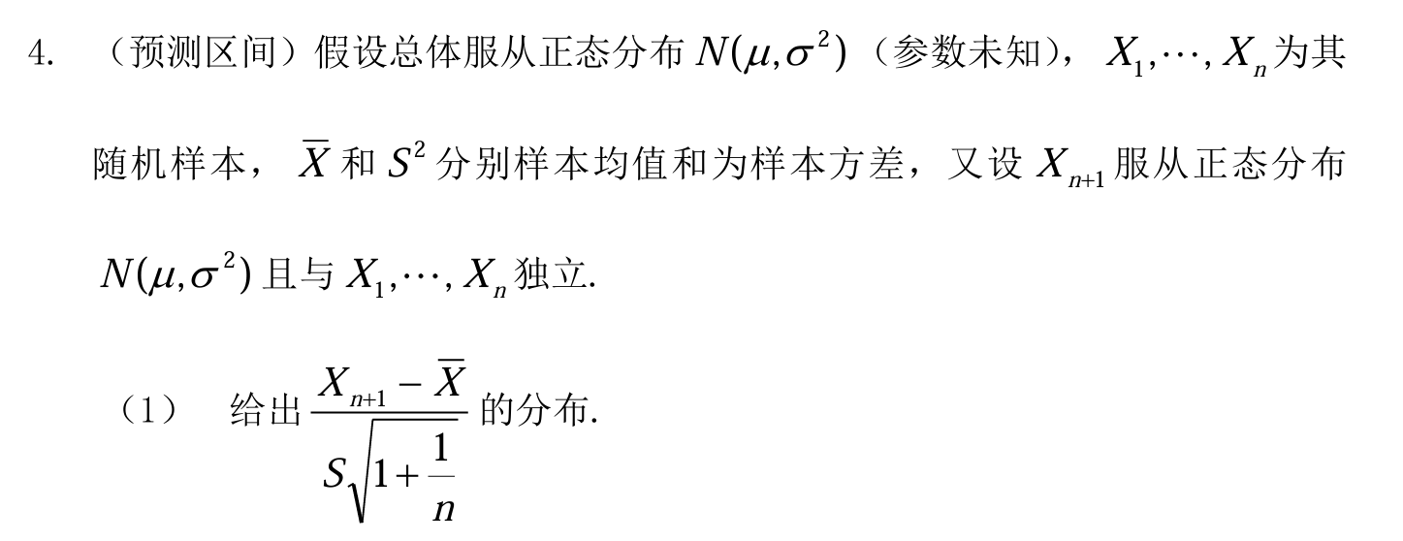
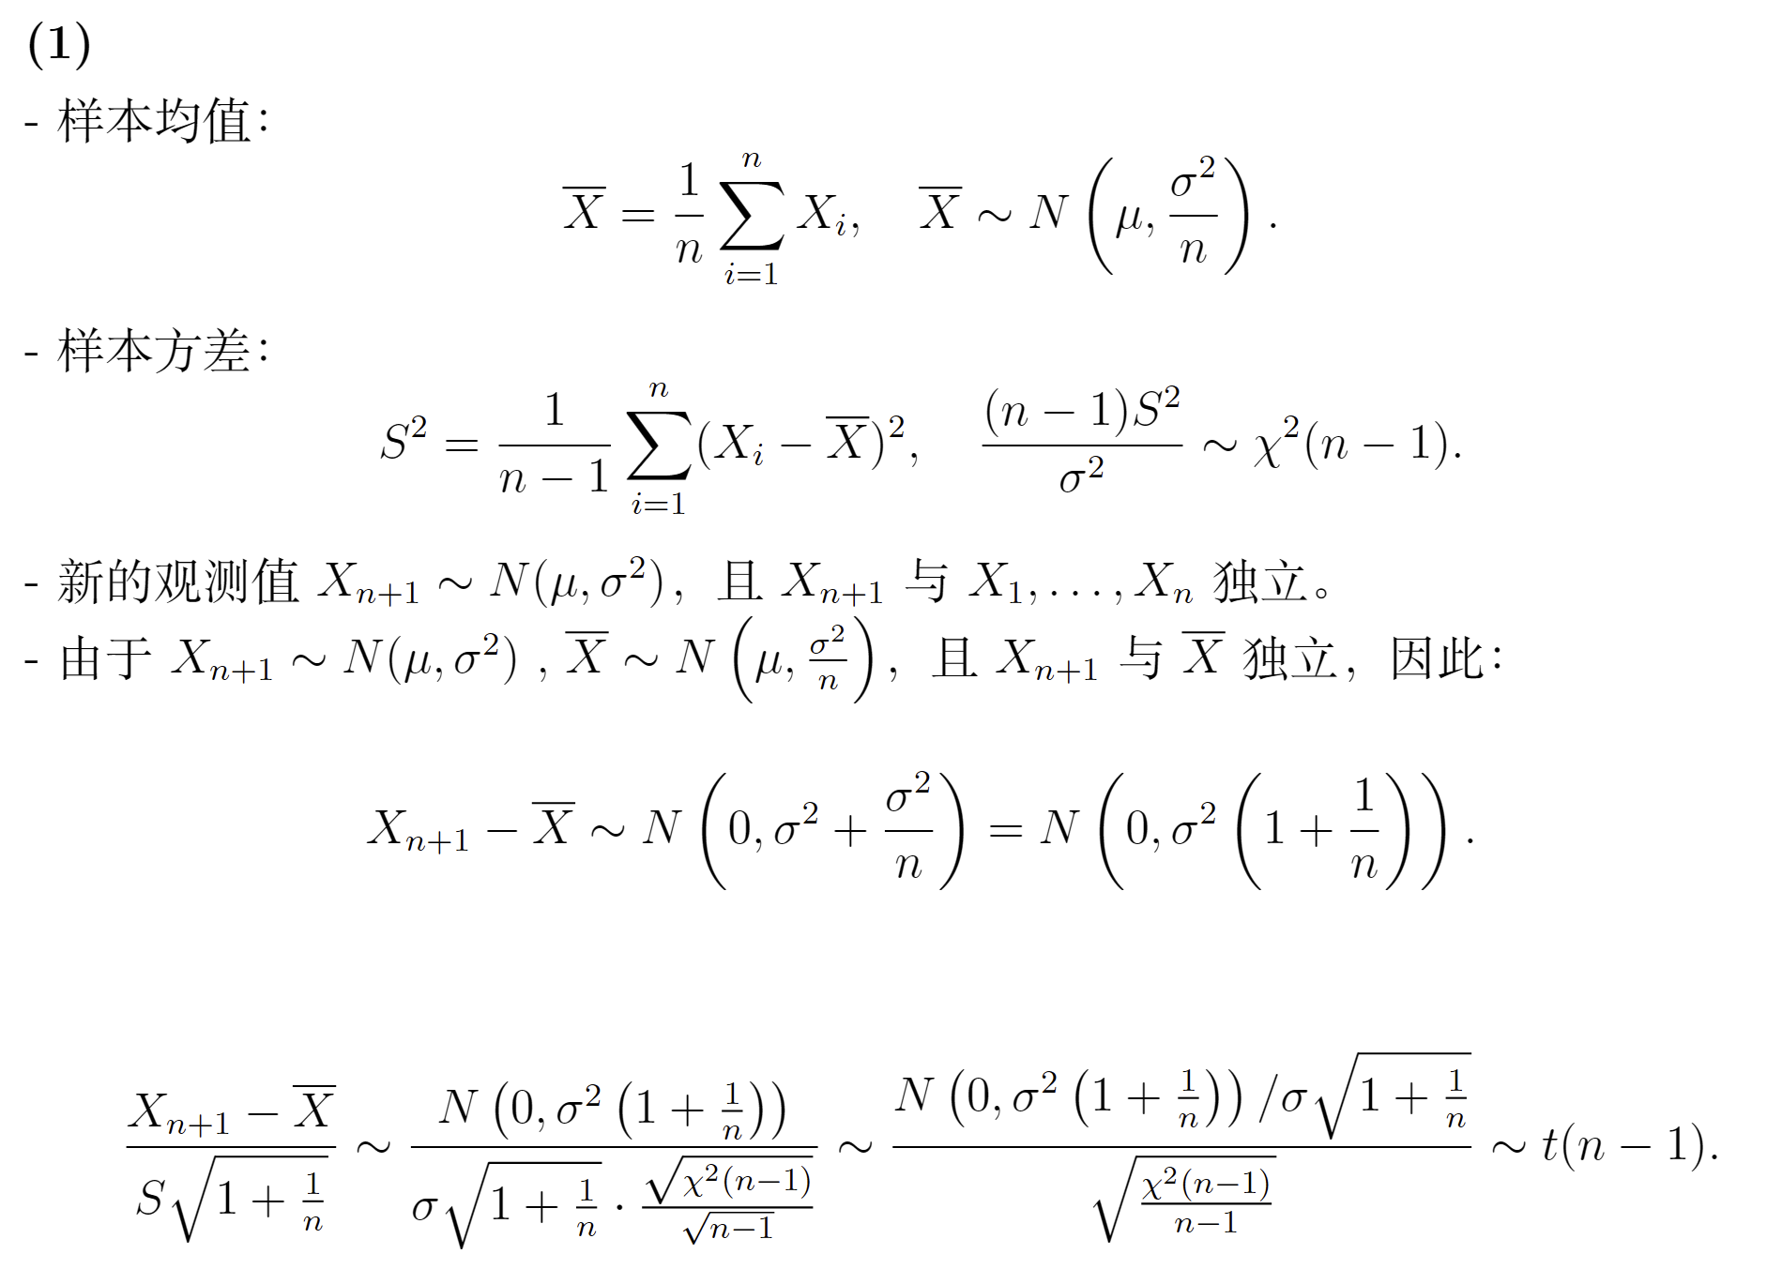

Slide 9
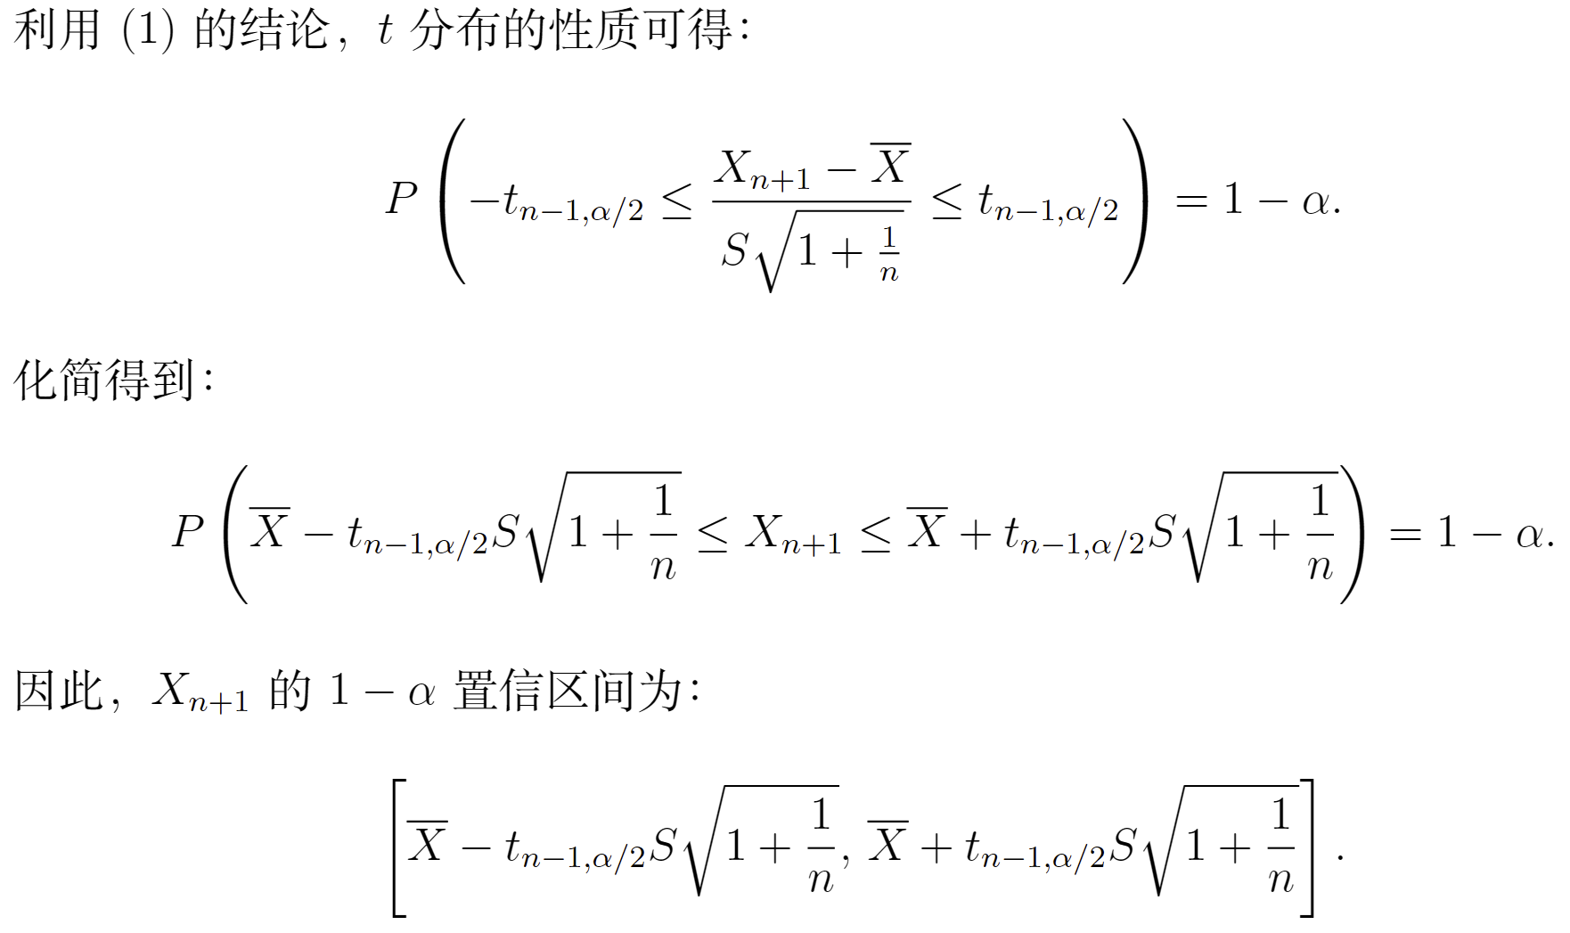

Slide 10
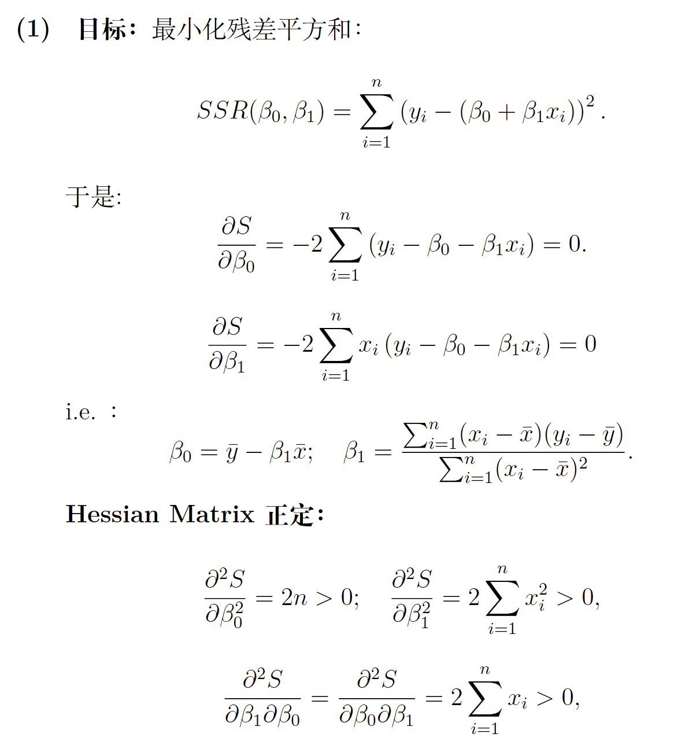
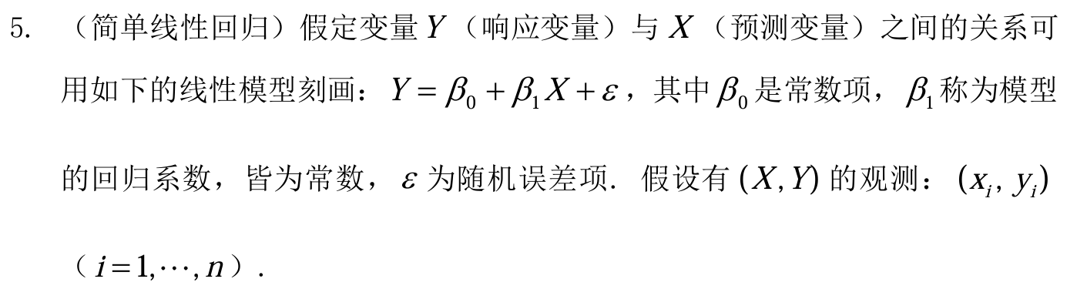
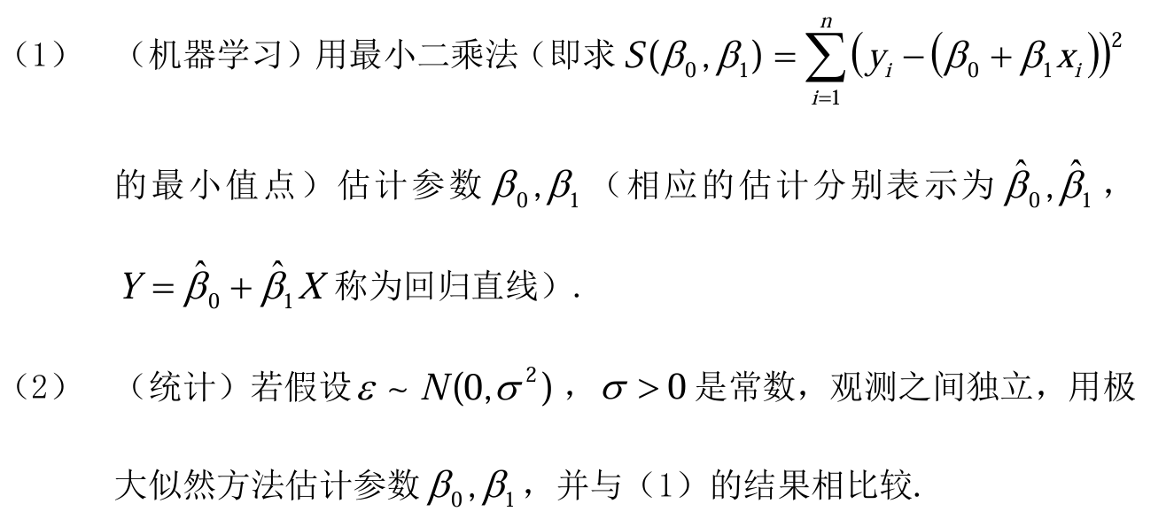

Slide 11
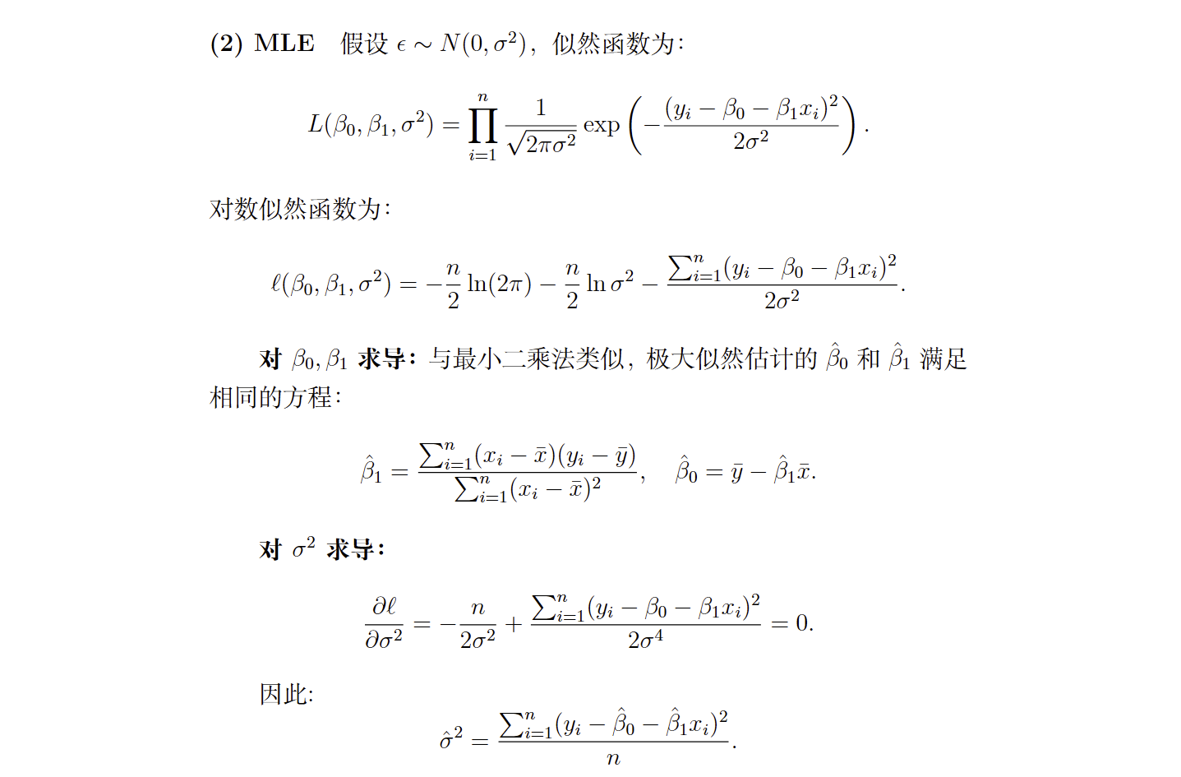

Slide 12
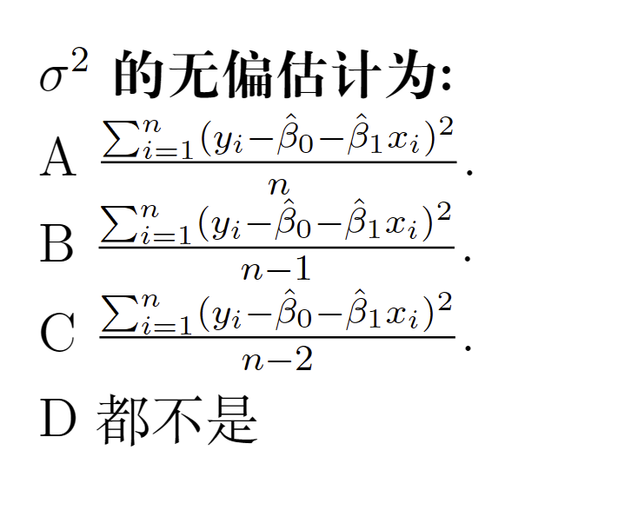

Slide 13
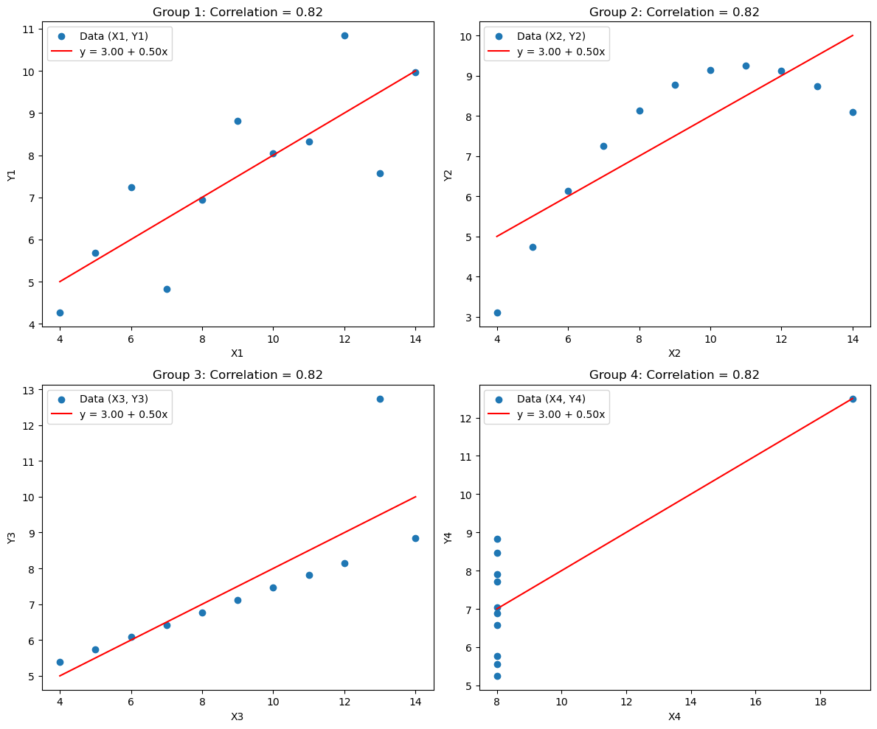
import numpy as np import pandas as pd import matplotlib.pyplot as plt import statsmodels.api as sm from scipy.stats import pearsonr # 数据 data = { 'X1': [10, 8, 13, 9, 11, 14, 6, 4, 12, 7, 5], 'Y1': [8.04, 6.95, 7.58, 8.81, 8.33, 9.96, 7.24, 4.26, 10.84, 4.82, 5.68], 'X2': [10, 8, 13, 9, 11, 14, 6, 4, 12, 7, 5], 'Y2': [9.14, 8.14, 8.74, 8.77, 9.26, 8.1, 6.13, 3.1, 9.13, 7.26, 4.74], 'X3': [10, 8, 13, 9, 11, 14, 6, 4, 12, 7, 5], 'Y3': [7.46, 6.77, 12.74, 7.11, 7.81, 8.84, 6.08, 5.39, 8.15, 6.42, 5.73], 'X4': [8, 8, 8, 8, 8, 8, 8, 19, 8, 8, 8], 'Y4': [6.58, 5.76, 7.71, 8.84, 8.47, 7.04, 5.25, 12.5, 5.56, 7.91, 6.89] } # 函数：使用 statsmodels 进行回归 def fit_linear_regression(x, y): x = sm.add_constant(x) # 添加常数项 model = sm.OLS(y, x).fit() # 拟合线性回归模型 return model # 绘制散点图和回归直线 fig, axes = plt.subplots(2, 2, figsize=(12, 10)) axes = axes.ravel() for i, (key_x, key_y) in enumerate(zip(["X1", "X2", "X3", "X4"], ["Y1", "Y2", "Y3", "Y4"])): x, y = data[key_x], data[key_y] # 回归模型拟合 model = fit_linear_regression(x, y) intercept, slope = model.params # 计算相关系数 r, _ = pearsonr(x, y) # 绘制散点图 axes[i].scatter(x, y, label=f"Data ({key_x}, {key_y})") # 绘制回归直线 x_line = np.linspace(min(x), max(x), 100) y_line = intercept + slope * x_line axes[i].plot(x_line, y_line, color="red", label=f"y = {intercept:.2f} + {slope:.2f}x") # 设置标题和标签 axes[i].set_title(f"Group {i+1}: Correlation = {r:.2f}") axes[i].set_xlabel(key_x) axes[i].set_ylabel(key_y) axes[i].legend() plt.tight_layout() plt.show()

Slide 14
Thanks

